Slide 1
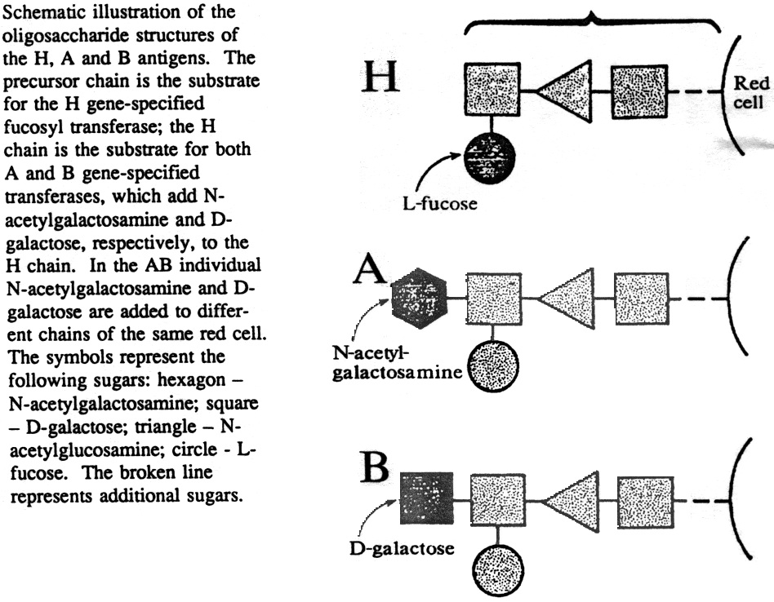

Slide 2
Monohybrid vs Dihybrid Cross
A monohybrid cross is one where only one trait is crossed.
e.g. A tall pea plant TT is crosses with a short pea plant tt.
A dihybrid cross is one where two traits are crossed.
e.g. a tall, purple flowered plant TtGg is crossed with a short, white flowered plant ttgg.

Slide 3
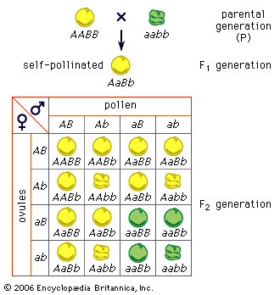
Law of Independent Assortment
The Punnett square is a diagram that is used to predict an outcome of a particular cross or breeding experiment
F2 Ratio- 9 (round, yellow):3 (round, green):3 (wrinkled, yellow):1 (wrinkled , green)

Slide 4
Law of Independent Assortment
The Law of Independent Assortment, also known as "Inheritance Law", states that alleles of different genes assort independently of one another during gamete formation.
F2 Ratio-9:3:3:1

Slide 5
Law of independent assortment
The Law of Independent Assortment, also known as "Inheritance Law", states that alleles of different genes assort independently of one another during gamete formation.

Slide 6
What is the Trihybrid ratio (in F2)?
T- tall, t- short
Y- yellow seed, y –green seed
R- round seed, r- wrinkled seed
TTYYRR X ttyyrr
Tall plant
With yellow
Round seeds
Short plant
With green
wrinkled seeds

Slide 7
TTYYRR X ttyyrr TtYyRr (Self)
gametes | TYR | TYr | TyR | Tyr | tYR | tYr | tyR | tyr
TYR | TTYYRR | TTYYRr | TTYyRR | TTYyRr | TtTTRR | TtTTRr | TtYyRR | TtYyRr
TYr | TTYYRr | TTYYrr | TTYyRr | TTYyrr | TtYYRr | TtYYrr | TtYyRr | TtYyrr
TyR | TTYyRR | TTYyRr | TTyyRR | TTyyRr | TtYyRR | TtYyRr | TtyyRR | TtyyRr
Tyr | TTYyRr | TTYyrr | TTyyRr | TTyyrr | TtYyRr | TtYyrr | TtyyRr | Ttyyrr
tYR | TtYYRr | TtYYRr | TtYyRr | TtYyRr | ttYYRR | ttYYRr | ttYyRR | ttYyRr
tYr | TtYYRr | TtYYrr | TtYyRr | TtYyrr | ttYYRr | ttYYrr | ttYyRr | ttYyrr
tyR | TtYyR | TtYyRr | TtyyRr | TtyyRr | ttYyRR | ttYyRr | ttyyRR | ttyyRr
tyr | TtYyRr | TtYyrr | TtyyRr | Ttyyrr | ttYyRr | ttYyrr | ttyyRr | ttyyrr
Tall, round, yellow- 27
Tall , yellow , wrinkled- 9
Tall , green, round - 9
Short, yellow, round - 9
Tall, green, wrinkled - 3
Short, yellow, wrinkled- 3
Short, green, round - 3
Short, green, wrinkled- 1

Slide 8
Allele Segregation
Chr 1
Chr 2
A
a
B
b
BbAa- genotype
2N
N
N
N
N
a
A
A
a
b
B
b
B
GAMETE 1
GAMETE 2
GAMETE 3
GAMETE 4
ba- genotype
BA- genotype
bA- genotype
Ba- genotype

Slide 9
Allele Segregation
Chr 1
Chr 2
A
A
B
b
BbAA- genotype
2N
N
N
N
N
A
A
A
A
b
B
b
B
GAMETE 1
GAMETE 2
GAMETE 3
GAMETE 4
bA- genotype
BA- genotype
bA- genotype
BA- genotype

Slide 10
Punnett Square
Gametes
ba
BA
bA
Ba
bA
bbAa
BbAA
bbAA
BbAa
BA
BbAa
BBAA
BbAA
BBAa
bA
bbAa
BbAA
bbAA
BbAa
BA
BbAa
BbAA
BbAA
BBAa
The Punnett square is a diagram that is used to predict an outcome of a particular cross or breeding experiment.

Slide 11
Exercises
What gametes are possible from the individuals with the following alleles?
(a) AaBb
(b) CCDd
(c) EeFF
(d) GGHH
(e) JjKk

Slide 12
In guinea pigs, colour of coat can be determined by three allelic combination of a gene. Yellow coat is determined by the homozygous genotype YY, white by the homozygous genotype WW, and cream by the heterozygous genotype YW. Determine the expected genotype and phenotype ratio of the F1 generation which would result from a cross between:
(a) Two cream coloured guinea pigs;
(b) A yellow coated and a cream coated anima

Slide 13
In humans the allele for albinism is recessive to allele for normal skin pigmentation.If two heterozygotes have children , what is the chance that a child will have normal skin color?

Slide 14
Achondroplasia (Dwarfism) is caused by a dominant allele. A dwarf man marries a dwarf woman. If homozygous Achondroplasia (dwarfs) results in death of embryo, list the genotype and phenotype of all potential live birth offsprings?

Slide 15
Question??
Chr 1
Chr 2
A
A
B
b
F2 Ratio-9:3:3:1

Slide 16
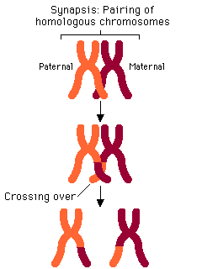
Crossing over results in Recombination of Alleles of different genes
B
B
b
b
A
a
a
A
b
B
b
B
A
a
a
A
B
B
b
b
A
a
A
a

Slide 17
What is Epistasis?
Epistasis is phenomenon where the effect of one gene (hypostatic) is modified by other gene (epistatic).
It is interaction between different genes (non alleles)
While, dominance is interaction between different alleles of the same gene

Slide 18
What is the dihydrid ratio?
9:3:3:1
Parental type
Parental type
Hybrid type

Slide 19
Modified Mendel Ratio in Wheat Kernel
For a trait contolled by two genes, these ratios will differ from the 9:3:3:1 that would be expected. These altered ratios are called modified Mendelian ratios.
Phenotypes: Kernel Color in Wheat
Parental Cross- AABB (coloured kernel) X aabb (colourless kernel)
F1 - coloured kernel (AaBb)
F2 - 15 Coloured kernel: 1 Colourless kernel

Slide 20
Punnett Square
Gametes | AB | Ab | aB | ab
AB | AABB (Colored) | AABb (Colored) | AaBB (Colored) | AaBb (Colored)
Ab | AABb (Colored) | Aabb (Colored) | AaBb (Colored) | Aabb (Colored)
aB | AaBB (Colored) | AaBb (Colored) | aaBB (Colored) | aaBb (Colored)
ab | AaBb (Colored) | Aabb (Colored) | aaBB (Colored) | aabb (Colorless)

Slide 21
Biochemical Explanation
Classic example of duplicate gene action
 | Gene A
 | Enzyme A
Precursor |  | Product (kernel colour)
 | Enzyme B
 | Gene B

Slide 22
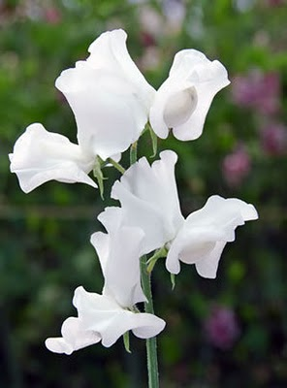
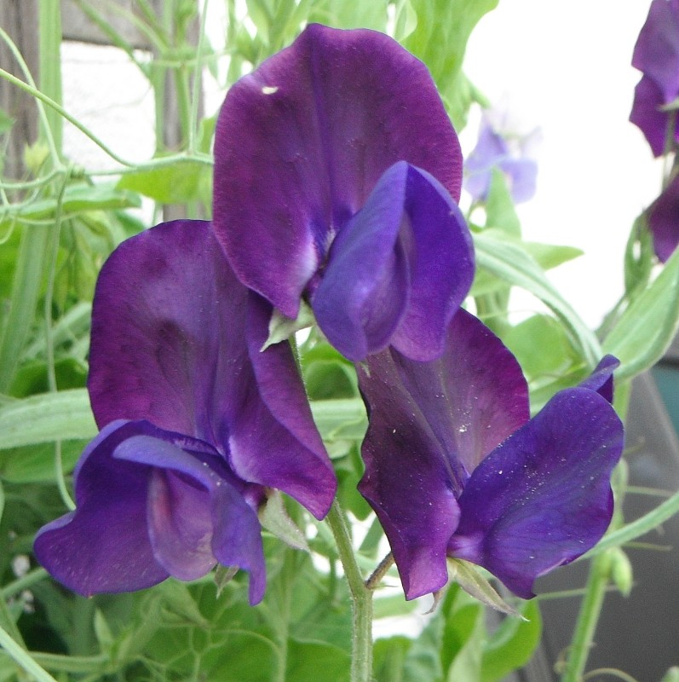
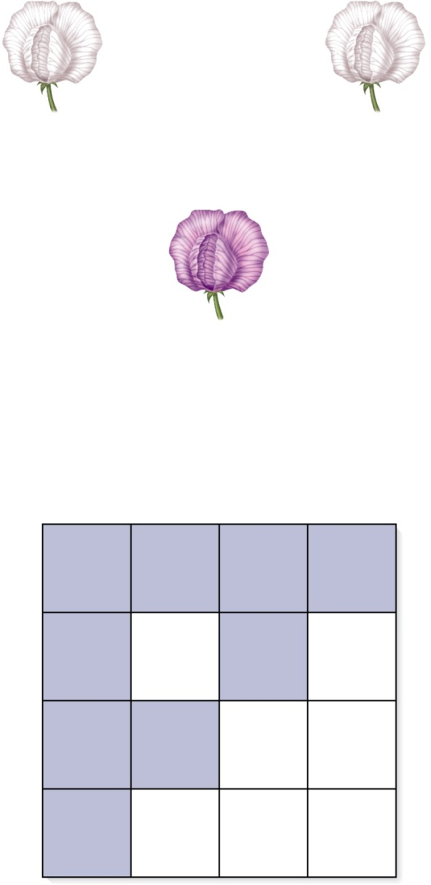
9:7 F2 ratio
x
White variety #1
(CCpp)
White variety #2
(ccPP )
F₁
All purple
(CcPp)
Self-fertilization
F₂
CP
Cp
cP
cp
CP
CCPP
Purple
CCPp
Purple
CcPP
Purple
CcPp
Purple
Cp
CCPp
Purple
CCpp
White
CcPp
Purple
Ccpp
White
cP
CcPP
Purple
CcPp
Purple
ccPP
White
ccPp
White
cp
CcPp
Purple
Ccpp
White
ccPp
White
ccpp
White

Slide 23
Possible biochemical mechanism?

Slide 24
Possible biochemical mechanism
Complementary Gene Action
Precursor (white)
Gene C Enzyme C
(Allele C) Intermediate (white)
Gene A Enzyme A
(Allele P)
Product (colored pigment)

Slide 25
Complementary gene action
A gene or genotype at one locus may produce a phenotype virtually identical to gene or genotype in another locus.
Enzyme C
Enzyme P
Precursor
Intermediate
Colored Product

Slide 26
Modified Mendel Ratio’s (9:7) (15:1) (13:3) (9:3:4)

Slide 27
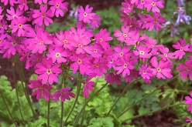
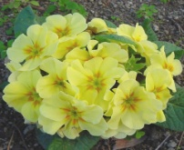
Modified Mendel Ratio in Primula
Phenotypes: Maldivin production in Primula
Parental Cross- Aabb (Maldivin producer) X aaBB(Maldivin non Producer)
F1 - Maldivin non Producer (AaBb)
F2 - 13 Maldivin non Producer : 3 Maldivin Producer

Slide 28
(Ratio: 13:3)
Gametes | AB | Ab | aB | ab
AB | AABB (Maldivin absent) | AABb (Maldivin absent) | AaBB (Maldivin absent) | AaBb (Maldivin absent)
Ab | AABb (Maldivin absent) | Aabb (Colored) | AaBb (Maldivin absent) | Aabb (Colored)
aB | AaBB (Maldivin absent) | AaBb (Maldivin absent) | aaBB (Maldivin absent) | aaBb (Maldivin absent)
ab | AaBb (Maldivin absent) | Aabb (Colored) | aaBB (Maldivin absent) | aabb (Maldivin absent)

Slide 29
How can you explain this?
It is a classic example of dominant suppression epistasis.
Dominant B allele masks the genes at the A locus
Genotype | Malvidin Production | Gene actions
9 A_B_ | No malvidin | no malvidin because dominant B allele is present
3 A_bb | Malvidin | malvidin productions because dominant A allele present
3 aaB_ | No malvidin | no malvidin because recessiveaand dominant B alleles present
1 aabb | No malvidin | no malvidin because recessive a allele present

Slide 30
Possible mechanism
B
Gene A
Enzyme A
X
(Precursor: White color)
Y
(Maldivin: colored Product)

Slide 31
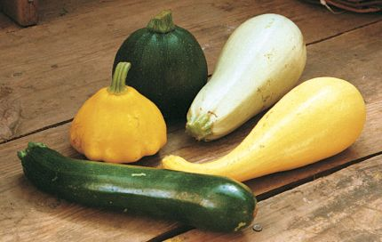
Dominant Epistasis
White (WWYY)
yellow (wwY_)
Green (wwyy)

Slide 32
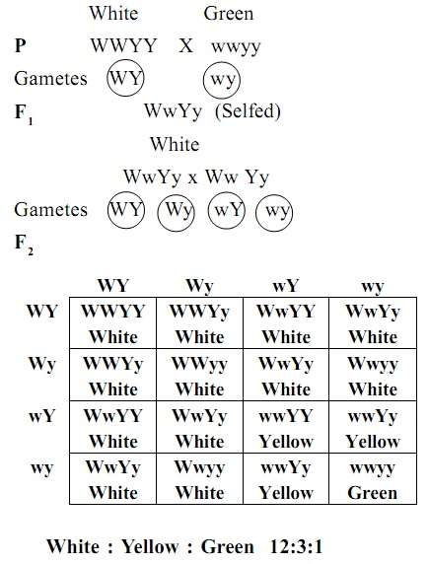
At the first gene locus white colored squash is dominant to colored squash, and the gene symbols are W=white and w=colored.
At the second gene yellow is dominant to green, and the symbols used are Y=yellow, y=green.

Slide 33
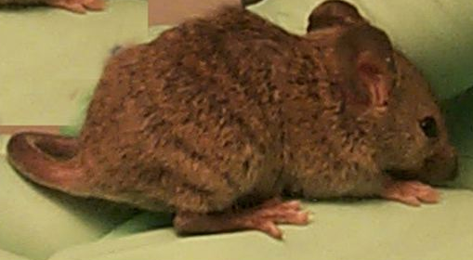
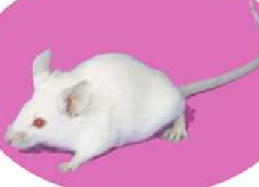
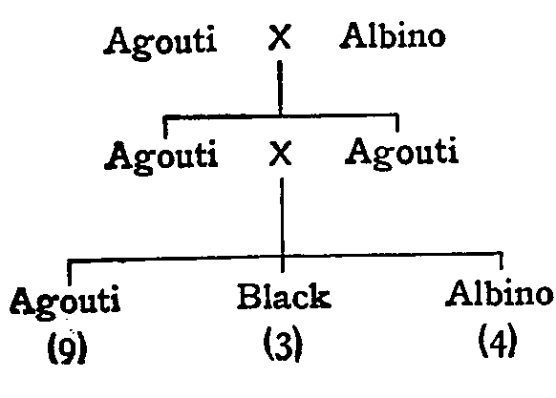
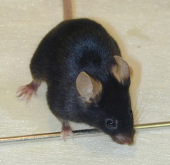
Modified Mendel Ratio in Coat color of mice
AACC
aacc
AaCc
AaCc
A_cc,
aacc
A_C_
aaC_

Slide 34
Gametes | AC | Ac | aC | ac
AC | AACC (Agouti) | AACc (Agouti) | AaCC (Agouti) | AaCc (Agouti)
Ac | AACc (Agouti) | AAcc (albino) | AaCc (Agouti) | Aacc (albino)
aC | AaCC (Agouti) | AaCc (Agouti) | aaCC (Black) | aaCc (Black)
ac | AaCc (Agouti) | Aacc (albino) | aaCC (Black) | aacc (albino)

Slide 35
Recessive Epistasis
In rodents, coat colour is determined by a pair of alleles at different genetic loci.
At one locus, the dominant allele C allows pigment formation ie. development of colour; the recessive allele c when homozygous prevents pigment formation regardless of the genotype of other coat colour genes.
Black mice are C/- ;
albinos are c/c.
At the other locus, the dominant allele A determines agouti pattern (ie. yellow
Banding of hairs) and the recessive allele a when homozygous produces non agouti
mice. Thus, A/- mice are agouti; a/a mice are non agouti.

